Slide 1
Introduction to Brain Anatomy
27 June 2016

Slide 2
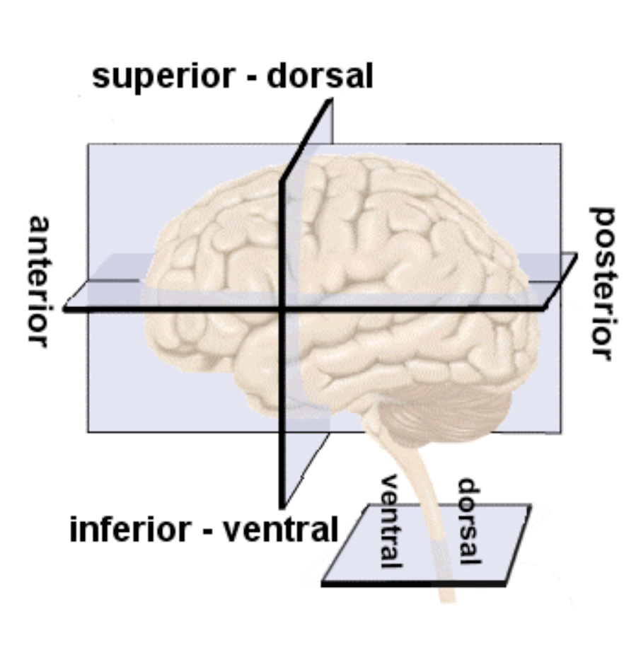

Slide 3
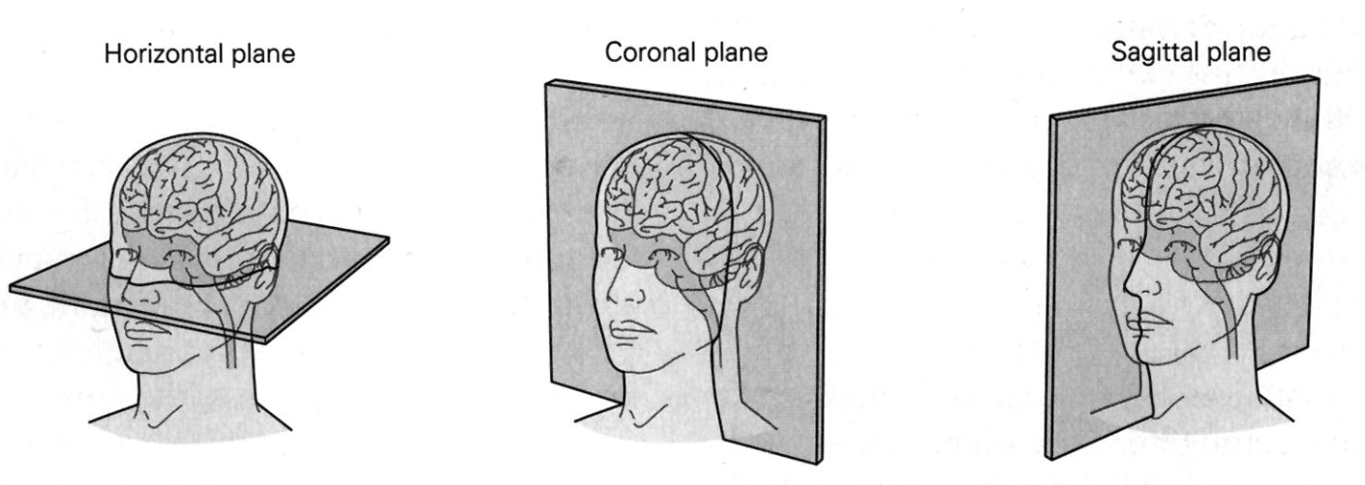

Slide 4
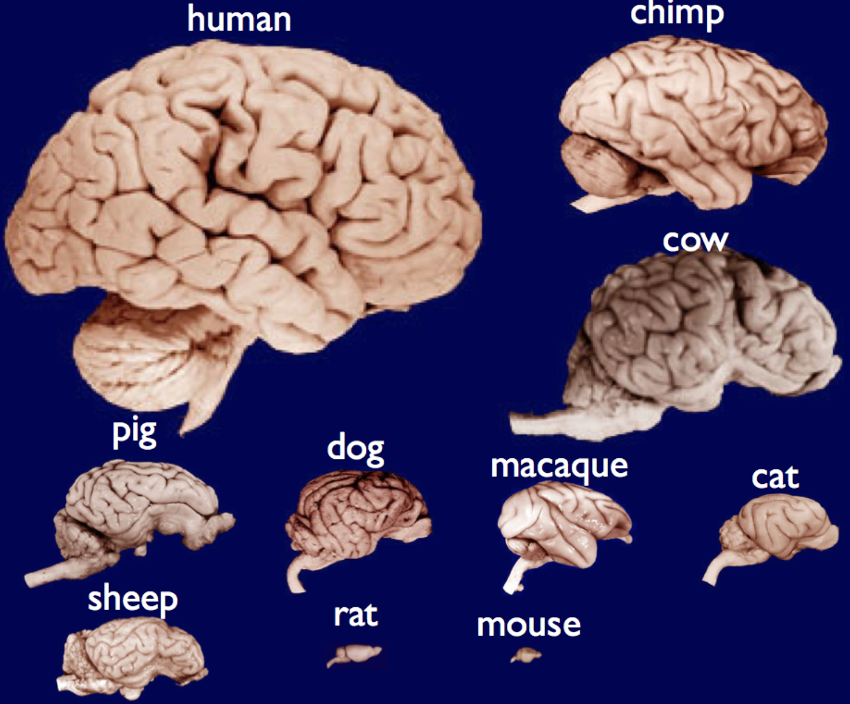
Fun facts:
Sperm whale brain is >6 times larger than human
Human brain weighs just 3 lbs but consumes 20-25% of all energy!
Many cases of people born with only half a brain functioning virtually normally

Slide 5
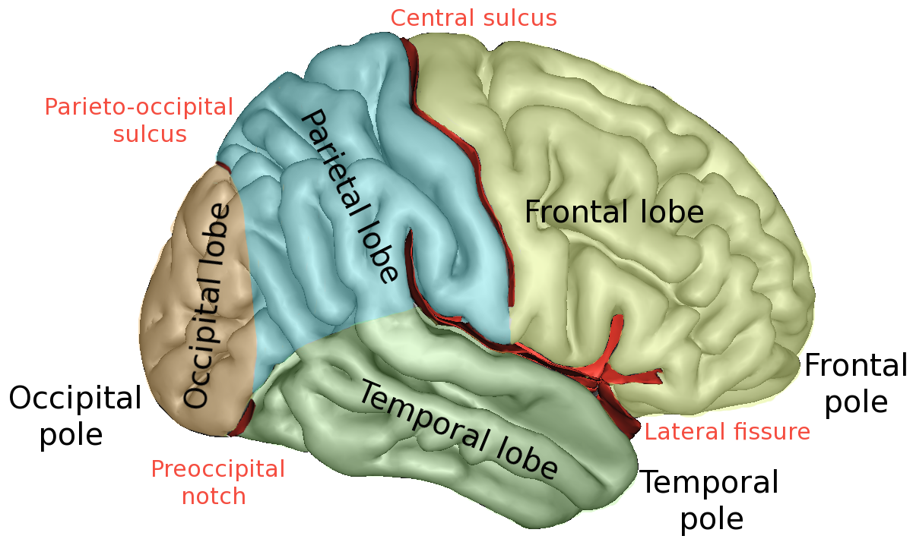
Major Subdivisions
Notes:
By Sebastian023, CC BY-SA 3.0, https://commons.wikimedia.org/w/index.php?curid=21020857

Slide 6
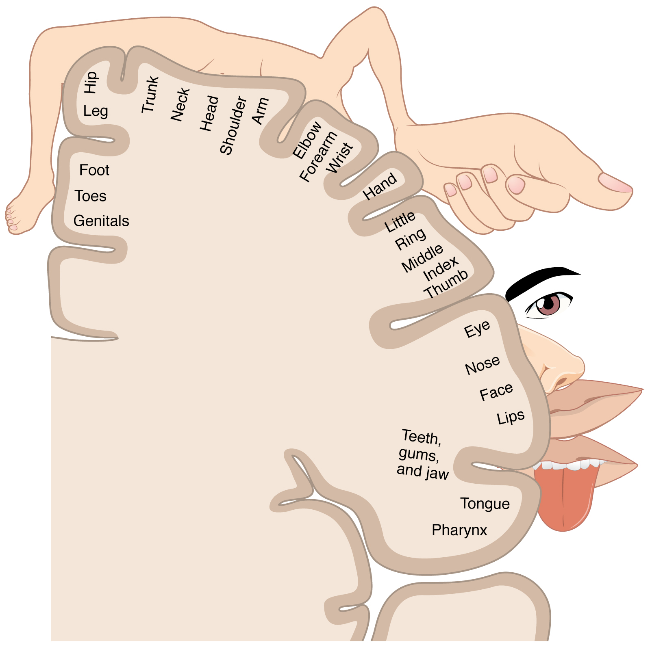
Homunculus (little man)
Motor Strip:
Pre-central gyrus (i.e., anterior of Central Sulcus)
Motor control
Sensory Strip:
Post-central gyrus (i.e., posterior of Central Sulcus)
Touch sensory processing
Size of body part indicates relative amount of cortical real estate devoted to that body part
Notes:
By OpenStax College - Anatomy & Physiology, Connexions Web site. http://cnx.org/content/col11496/1.6/, Jun 19, 2013., CC BY 3.0, https://commons.wikimedia.org/w/index.php?curid=30148008

Slide 7
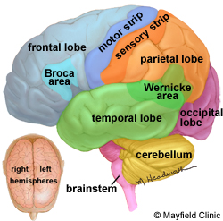
Frontal Lobe
Personality, behavior, emotions
Judgment, planning, problem solving
Speech: speaking and writing (Broca’s area)
Body movement (motor strip)
Intelligence, concentration, self awareness
Notes:
https://www.mayfieldclinic.com/PE-AnatBrain.htm

Slide 8
Parietal Lobe
Interprets language, words
Sense of touch, pain, temperature (sensory strip)
Interprets signals from vision, hearing, motor, sensory and memory
Spatial and visual perception
Integration!!
Notes:
https://www.mayfieldclinic.com/PE-AnatBrain.htm

Slide 9
Temporal Lobe
Understanding language (Wernicke’s area)
Memory
Hearing
Sequencing and organization
Notes:
https://www.mayfieldclinic.com/PE-AnatBrain.htm

Slide 10
Occipital Lobe
Interprets vision (color, light, movement)
Notes:
https://www.mayfieldclinic.com/PE-AnatBrain.htm

Slide 11
Cerebellum
Old School:
Only involved in motor related activities such coordination, timing, and learning
Wikipedia entry still focuses on this aspect!
Current:
Involved in everything including cognition, emotion processing, etc!!
Notes:
https://www.mayfieldclinic.com/PE-AnatBrain.htm

Slide 12
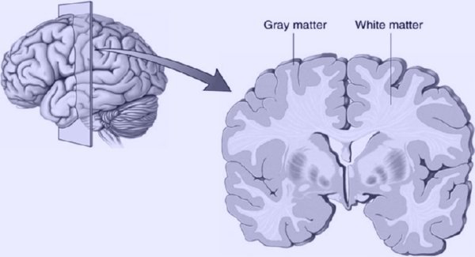
Gray Matter, White Matter, CSF
Gray Matter:
Mostly cortical mantel
Subcortical nuclei also considered gray matter
Consists of neurons, glia, synapses, etc
White Matter:
Axons
Connections between neurons
“Wiring” of the brain
CSF (Cerebrospinal fluid):
Cushions brain
Immunology protection
Notes:
http://www.inner-light-in.com/2015/01/how-to-increase-gray-matters-in-the-brain/

Slide 13
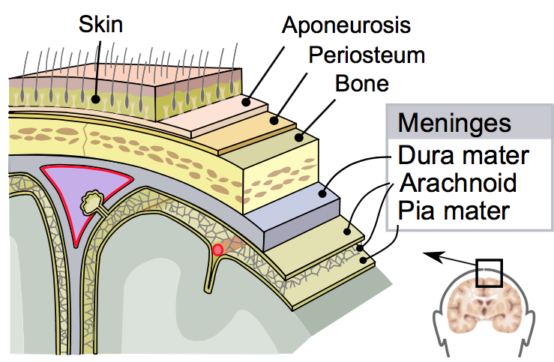
Meninges
Three membranes: dura mater, the arachnoid mater, and the pia mater
Envelops the brain and spinal cord
Cerebrospinal fluid located in space between arachnoid mater and pia mater
Primary function of the meninges is to protect the central nervous system
Pia mater located right on top of Gray Matter!
Notes:
By SVG by Mysid, original by SEER Development Team [1] - Vectorized in Inkscape by Mysid, based on work by SEER Development Team, Public Domain, https://commons.wikimedia.org/w/index.php?curid=10485059

Slide 14
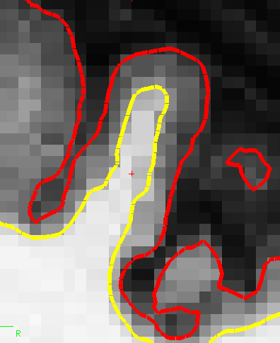
Cortical Thickness – Our Goal This Summer!!
pial surface
Cortical thickness – thickness of the gray matter in the cortical mantel
Measured as distance between gray matter and white matter (yellow boundary) to the gray matter and pial surface (red boundary)
FreeSurfer software semi-automatically calculates both boundaries and then the measures the thickness
Unfortunately it makes errors especially in red boundary!
😫

Slide 15
Introduction to Adolescent Development Study (ADS)
27 June 2016

Slide 16
Aims/Goals of the Adolescent Development Study (ADS)
Aim 1: Identify neurodevelopmental factors that predict the initiation/escalation of substance use
Aim 2: Developmental Impact of Substance Use
Expanded to also examine:
Genetics and epigenetics
Environmental factors: dietary factors (omega3 fatty acids and iron) and alcohol related advertising

Slide 17
ADS Study Design
Wave1 Wave2 Wave3
N: 135 111 ~105
Age: 11.0-13.0 yo 12.5-14.5 yo 14.0-16.0 yo
Users: 0 19 32
Adolescent Measures (~6 hrs)
MRI Structural & Functional (~1.5 hrs)
DTI MRI (white matter integrity)
fMRI – Continuous Performance Task
fMRI – Wheel of Fortune Task
fMRI – Emotional Counting Stroop
fMRI – Resting State
High resolution structural (cortical thickness, volume)
Outside scanner (~4.5 hrs)
Temporal Discounting, Facial Emotion recognition Task
KBIT, Trail Making, Spatial WM, Stockings of Cambridge
DUSI (Drug Use Survey Instrument)
Diet assessment (relative DHA intake)
Alcohol advertising exposure
Parent Measures (~2 hrs)
Demographics, factors related to Social Economic Status (SES)
AUDIT (self report of alcohol use)
Family History of Drug/Alcohol Use
Perinatal questionnaire
BRIEF (parent report of child’s executive function and impulsivity)
ADHD Rating Scale (parent rating of child)
Temperament Scale (parent rating of child)

Slide 18
ADS Sample Characteristics
Sample of 142 adolescents very representative of the racial and SES makeup of the D.C. metro region
Wave 2 111 completed (>82%)
Wave 3 108 completed (last ones tested this past weekend!)
N | 135 (73F,62M)
Age | 12.7(0.8)
Pubertal status | 2.2(0.70)
Race and Ethnicity
African American | 45 (33%)
Caucasian | 70 (51.9%)
Hispanic/Latino | 9 (6.7%)
Other | 11 (8.1%)
Socioeconomic Status
Parent cumulative years education, mean | 16.2(2.9)
Household income Mean Median | $50,000 -$74,999 $100,000-$149,000
IQ (KBIT) | 108.8(15.3)
Alcohol Risk distribution (from DUSI-QS)
Low (%) | 116 (85.9%)
Medium (%) | 8 (5.9%)
High (%) | 11 (8.1%)
Notes:
Median incomes: DC $52K, MD $70K, VA $62K
Race/Ethnicity:
DC: 51% African-American, 40% Caucasian, 10% Hispanic
VA: 20% African-American, 71% Caucasian, 9% Hispanic
MD: 30% African-American, 61% Caucasian, 9% Hispanic

Slide 19
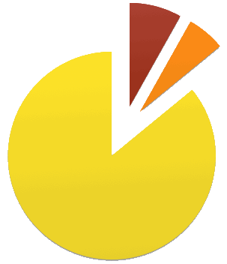
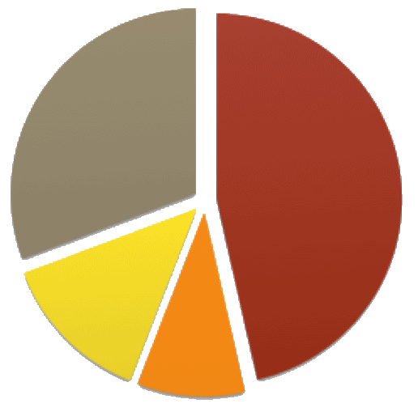
ADS Sample by Risk
DUSI-QS*
Family History
(*73% predictive of SUD by age 22)
High Risk = 8.1%
Med. Risk = 5.9%
No FH = 30.7%
Alcohol = 46.5%
Alcohol + Drug
= 13.4%
Low Risk = 86%
Drug
= 9.4%

Slide 20
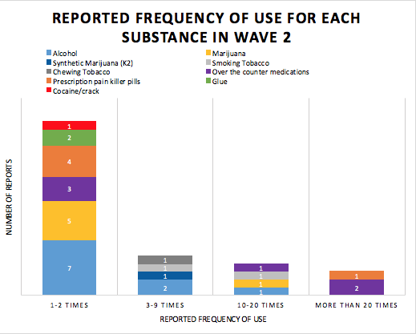
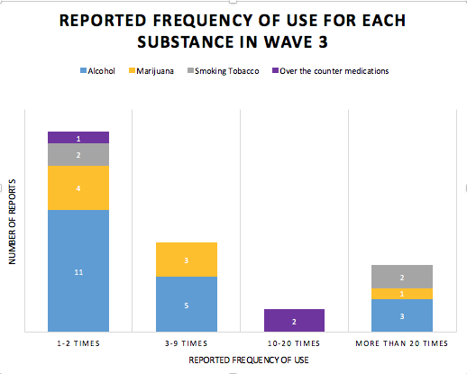
Frequency of Use by Substance
Wave 2 Wave 3
* Based on DUSI

